Slide 1
Ansible Network Automation

Slide 2
Overview
●
Introduction to Ansible automation
●
How Ansible works for network automation
●
●
Understanding Ansible modules and playbooks
●
●
Executing Ansible playbooks to:
Make configuration changes
Gather information - Ansible facts
●
Writing Ansible Modules
Resource Module Builder
Restconf
JSONRPC

Slide 3
What is Ansible?
●
An Open Source Automation Tool
●
Ansible Engine runs Ansible Playbooks, the automation language, that can perfectly describe an IT application infrastructure.
●
Ansible Automation is the enterprise framework for automating across IT operations.
Notes:
IT automation and configuration management tool. Emerged in 2012, networking modules in release 2.x - 2016.
Alternates - Chef, Puppet.
71% of networks are still driven manually via CLI.

Slide 4
Community
ONE OF THE MOST POPULAR OPEN-SOURCE AUTOMATION COMMUNITY ON GITHUB
●
Top 10 open source projects in 2017
●
39,000+ stars & 16,000+ forks on GitHub
●
4,600+ GitHub Contributors
●
500,000+ downloads a month
●
Over 3000 modules shipped with Ansible
●
65+ Network Platforms
●
1000+ Network Modules
●
15 Galaxy Network Roles
ansible.com/for/networks
Notes:
Ansible Galaxy - Jump-start your automation project with great content from the Ansible community. Galaxy provides pre-packaged units of work known to Ansible as roles.
Roles are ways of automatically loading certain vars_files, tasks, and handlers based on a known file structure. Grouping content by roles also allows easy sharing of roles with other users.

Slide 5



Why Ansible?
(for networks)
SIMPLE
POWERFUL
AGENTLESS
For operators, not developers
Connect via Plugins
Ideal for network gear
Download and go
Easy platform enablement
No agents to exploit or update
Existing knowledge reuse
Leverage Linux Tools
Standards-based SSH
Notes:
Predictable outcome; reduces human error

Slide 6
WHAT CAN I DO USING ANSIBLE?
Automate the deployment and management of your entire IT footprint.
Do this...
Orchestration
Configuration
Application
Provisioning
Continuous
Security and
Management
Deployment
Delivery
Compliance
On these...
Firewalls
Load Balancers
Applications
Containers
Clouds
Servers
Infrastructure
Storage
Network Devices
And more...
Notes:
Generate, push, save and collect device config. Upgrade devices.

Slide 7
ANSIBLE AUTOMATES TECHNOLOGIES YOU USE
Time to automate is measured in minutes
CLOUD
VIRT &
CONTAINER
WINDOWS
NETWORK
DEVOPS
MONITORING
AWS
Docker
ACLs
Arista
Jira
Dynatrace
Azure
VMware
Files
A10
GitHub
Airbrake
Digital Ocean
RHV
Packages
Cumulus
Vagrant
BigPanda
Google
OpenStack
IIS
Bigswitch
Jenkins
Datadog
OpenStack
OpenShift
Regedits
Cisco
Bamboo
LogicMonitor
Rackspace
+more
Shares
Cumulus
Atlassian
Nagios
+more
Services
Dell
Subversion
New Relic
Conﬁgs
Extreme
Slack
PagerDuty
OPERATING
STORAGE
Users
Juniper
Hipchat
Sensu
SYSTEMS
NetApp
Domains
Palo Alto
RHEL and Linux
+more
StackDriver
Red Hat Storage
+more
OpenSwitch
Zabbix
UNIX
Inﬁnidat
+more
+more
Windows
+more
+more

Slide 8










PUBLIC / PRIVATE
CLOUD
PUBLIC / PRIVATE
CMDB
CLOUD
ANSIBLE AUTOMATION ENGINE
USERS
INVENTORY
CLI
HOSTS
MODULES
PLUGINS
NETWORK
ANSIBLE
DEVICES
PLAYBOOK

Slide 9







PUBLIC / PRIVATE
CLOUD
PUBLIC / PRIVATE
CMDB
CLOUD
ANSIBLE AUTOMATION ENGINE
PLAYBOOKS ARE WRITTEN IN YAML
Tasks are executed sequentially
USERS
Invoke Ansible modules
INVENTORY
CLI
HOSTS
MODULES
PLUGINS
NETWORK
ANSIBLE
DEVICES
PLAYBOOK

Slide 10

PUBLIC / PRIVATE
CLOUD
PUBLIC / PRIVATE
CMDB
CLOUD
ANSIBLE AUTOMATION ENGINE
MODULES ARE “TOOLS IN THE TOOLKIT”
Python, Powershell, or any language
Extend Ansible simplicity to the entire stack
USERS
INVENTORY
CLI
HOSTS
MODULES
PLUGINS
NETWORK
ANSIBLE
DEVICES
PLAYBOOK
CORE
NETWORK
COMMUNITY

Slide 11
PUBLIC / PRIVATE
CLOUD
PUBLIC / PRIVATE
CMDB
CLOUD
PLUGINS ARE “GEARS IN THE ENGINE”
Code that plugs into the core engine
ANSIBLE AUTOMATION ENGINE
Adaptability for various uses & platforms
USERS
INVENTORY
CLI
HOSTS
MODULES
PLUGINS
NETWORK
ANSIBLE
DEVICES
PLAYBOOK

Slide 12
PUBLIC / PRIVATE
CLOUD
PUBLIC / PRIVATE
CMDB
CLOUD
INVENTORY
[NW_CLI] SW1 ansible_host=10.68.5.64 SW2 ansible_host=10.68.5.65 [NW_CLI:vars] ansible_network_os=exos ansible_connection=network_cli ansible_user=admin ansible_ssh_pass=""
[HTTPAPI] R_SW1 ansible_host=10.68.5.64 R_SW2 ansible_host=10.68.5.65 [HTTPAPI:vars] ansible_network_os=exos ansible_connection=httpapi ansible_user=admin ansible_ssh_pass=
ANSIBLE AUTOMATION ENGINE
USERS
INVENTORY
CLI
HOSTS
MODULES
PLUGINS
NETWORK
ANSIBLE
DEVICES
PLAYBOOK
Notes:
Inventory is a collection of managed hosts with associated data and groupings that Ansible can connect and manage.
Hosts
Groups
Static or dynamic sources
There is always a group called "all" by default
Groups can be nested
[routers:children]
slx exos
voss

Slide 13
PUBLIC / PRIVATE
CLOUD
PUBLIC / PRIVATE
CMDB
CLOUD
ANSIBLE AUTOMATION ENGINE
USERS
INVENTORY
CLI
HOSTS
MODULES
PLUGINS
NETWORK
AUTOMATE EVERYTHING
ANSIBLE
DEVICES
Red Hat Enterprise Linux, Ubuntu, Debian,
PLAYBOOK
Cisco routers, Extreme switches, Juniper routers,
Windows hosts, Checkpoint ﬁrewalls and more
Notes:
SSH, Restconf, Netconf, proprietary API

Slide 14
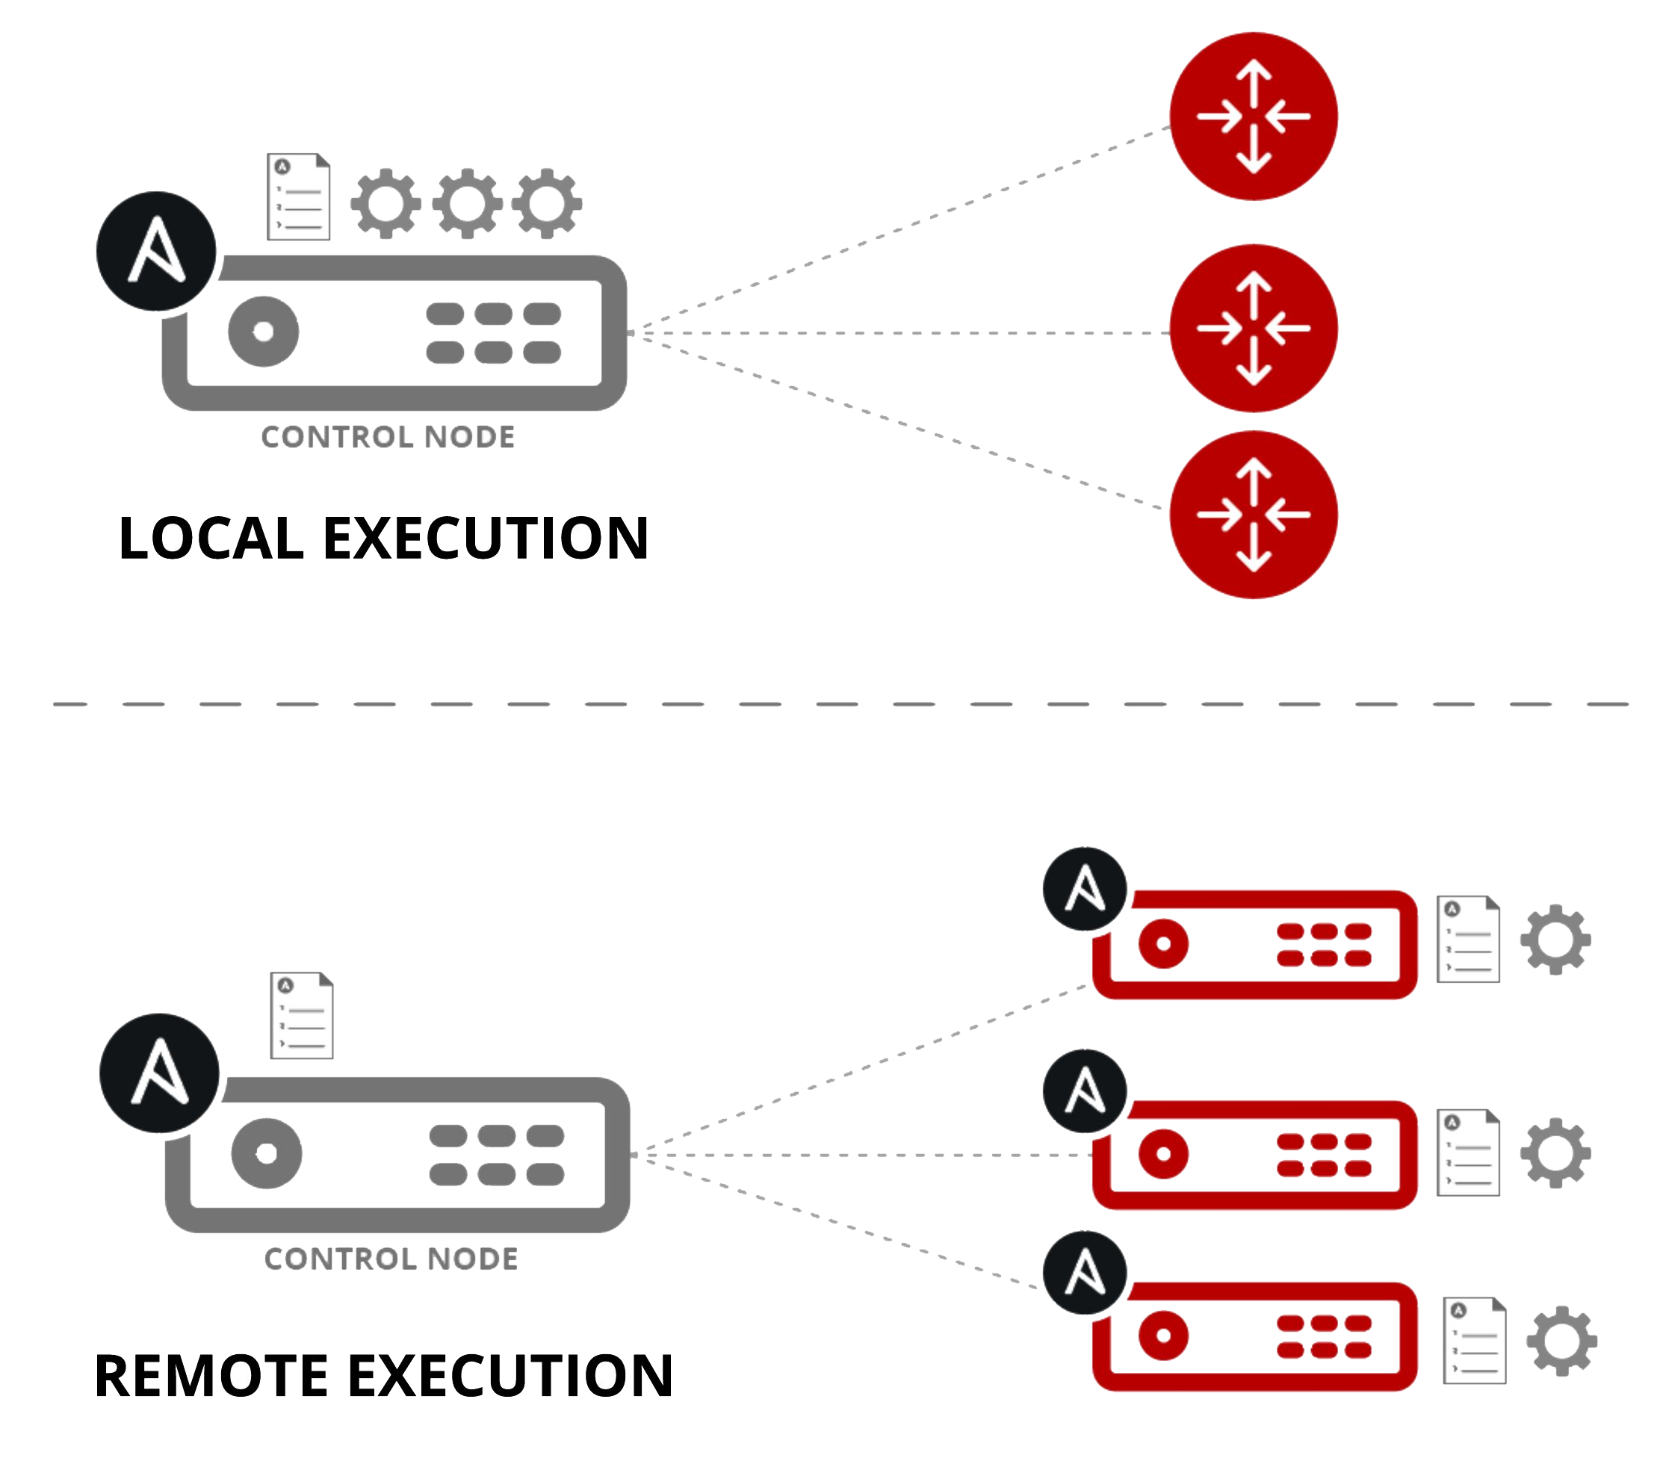
How Ansible Network Automation works
Module code is executed locally on the control node
NETWORKING DEVICES
Module code is copied to the managed node, executed, then removed
LINUX/WINDOWS HOSTS

Slide 15
Modules
Modules do the actual work in Ansible, they are what gets executed in each playbook task.
Typically written in Python (but not limited to it) and return JSON data
Modules can be idempotent
Modules take user input in the form of parameters
Ansible-doc module_name for help
UKOMARLA:ansible ukomarla$ ansible -m ping all R_SW1 | SUCCESS => { "ansible_facts": { "discovered_interpreter_python": "/usr/bin/python" }, "changed": false, "ping": "pong" }
Notes:
ansible -i inventory -m ping all -v ansible -i inventory -m exos_facts R_SW1 -v ansible -m exos_facts -a "gather_network_resources=vlans" -i ../DEVELOPMENT/ansible_hosts R_SW1 -v
Idempotence is the property of certain operations in mathematics and computer science whereby they can be applied multiple times without changing the result beyond the initial application.

Slide 16
Network modules
Ansible modules for network automation typically references the vendor OS followed by the module name.
Arista EOS = eos_*
Cisco IOS/IOS-XE = ios_*
Cisco NX-OS = nxos_*
Extreme Networks EXOS = exos_*
Extreme Networks SLX = slxos_*
Extreme Networks VOSS = voss_*
Juniper Junos = junos_*
VyOS = vyos_*
*_facts
*_command
*_conﬁg
More modules depending on platform

Slide 17
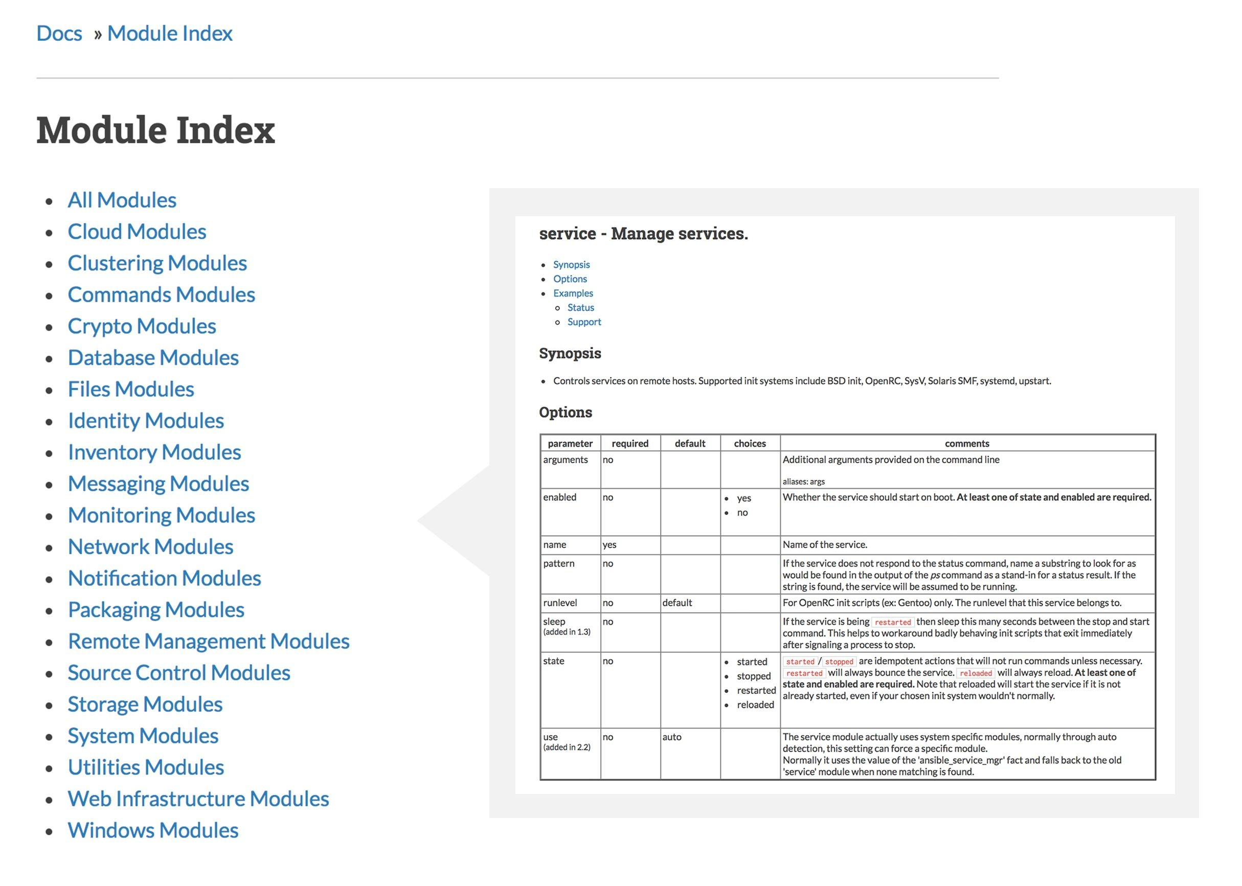
Module Documentation
Documentation is required as part of module submission
Multiple Examples for every module
Broken into relevant sections
Ansible Module Documentation: https://docs.ansible.com/
Ansible for Network Automation: http://bit.ly/AnsibleNetwork

Slide 18
Fact modules return structured data
X460G2-24t-10G4.8 # sh version Switch : 800549-00-06 1538N-42127 Rev 06 BootROM: 1.0.2.3 IMG: 30.5.0.61 PSU-1 : Internal PSU-1 800515-00-04 1534E-40764 Rev 04 Image : ExtremeXOS version 30.5.0.61 xos_30.5 by ukomarla on Fri Sep 13 18:46:39 EDT 2019 BootROM : 1.0.2.3 Diagnostics : 5.12 Certified Version : EXOS Linux 4.14.123, FIPS fips-ecp-2.0.16
UKOMARLA:ansible ukomarla$ ansible -m exos_facts R_SW1 ok: [R_SW1] => {"ansible_facts": { "ansible_net_hostname": "X460G2-24t-10G4", "ansible_net_interfaces": {"1": {}, "Default": {}, "Mgmt": {}}, "ansible_net_memfree_mb": 686, "ansible_net_memtotal_mb": 1024, "ansible_net_model": "X460G2-24t-10G4", "ansible_net_serialnum": "1538N-42127", "ansible_net_version": "30.5.0.61", "ansible_network_resources": {} }, "changed": false}

Slide 19
Plays & Playbooks
Plays are ordered sets of tasks to execute against host selections from
your inventory. A playbook is a ﬁle containing one or more plays.
Expressed in YAML - Easier for humans to read write than XML/JSON.

Slide 20
An Ansible Playbook Example
--- - name: snmp ro/rw string conﬁguration hosts: exos gather_facts: no tasks: - name: ensure that the desired snmp strings are present exos_config: lines: - configure snmpv3 add community "ansible-private" name "ansible-private" user "v1v2c_rw" - configure snmpv3 add community "ansible-public" name "ansible-public" user "v1v2c_ro"

Slide 21
Running a playbook
$ ansible-playbook -i ansible_hosts snmp.yaml -v Using /Users/ukomarla/.ansible.cfg as config file PLAY [snmp ro/rw string conﬁguration] ******************************************* TASK [ensure that the desired snmp strings are present] **************************************** changed: [R_SW1] => {"ansible_facts": {"discovered_interpreter_python": "/usr/bin/python"}, "changed": true, "commands": ["configure snmpv3 add community \"ansible-private\" name \"ansible-private\" user \"v1v2c_rw\"", "configure snmpv3 add community \"ansible-public\" name \"ansible-public\" user \"v1v2c_ro\""], "updates": ["configure snmpv3 add community \"ansible-private\" name \"ansible-private\" user \"v1v2c_rw\"", "configure snmpv3 add community \"ansible-public\" name \"ansible-public\" user \"v1v2c_ro\""]} PLAY RECAP ************************************************** R_SW1 : ok=1 changed=1 unreachable=0 failed=0 skipped=0 rescued=0 ignored=0 $ ansible-playbook -i ansible_hosts snmp.yaml -v Using /Users/ukomarla/.ansible.cfg as config file PLAY [snmp ro/rw string conﬁguration] ******************************************* TASK [ensure that the desired snmp strings are present] ***************************************** ok: [R_SW1] => {"ansible_facts": {"discovered_interpreter_python": "/usr/bin/python"}, "changed": false} PLAY RECAP ************************************************* R_SW1 : ok=1 changed=0 unreachable=0 failed=0 skipped=0 rescued=0 ignored=0

Slide 22
Ansible Module Development Demo
Resource Module Builder is an Ansible Playbook that helps developers scaffold and maintain an Ansible network resource module.
Capabilities
Use a defined model to scaffold a resource module directory layout and initial class files.
Subsequent uses of the Resource Module Builder (RMB) will only replace the module arspec and file containing the module doc string.
Complex examples can be stored along side the model in the same directory.
Maintain the model as the source of truth for the module and use RMB to update the source files as needed.
Generates working sample modules for both <network_os>_<resource> and <network_os>_facts
Demo Code is located on github
Notes:
Git repository with the files from demo: https://github.com/ujwalkomarla/Ansible_RMB_Demo
ansible-playbook -e rm_dest=~/github/exos_auto_save_cfg/ -e structure=role -e model=models/exos/auto_save_cfg/exos_auto_save_cfg.yaml site.yml

Slide 23
RESTCONF
A REST like protocol over HTTP for accessing data defined in YANG.
Supports GET, POST, PATCH, PUT, DELETE operations.
Request and response data is in JSON format.
Tools
Postman
Python Requests
EXOS Rest API Examples

Slide 24
Authorization Token
path: /auth/token method: POST data: { "username": "admin", "password": "" }

Slide 25
GET Operation
path: /rest/restconf/data/openconfig-vlan:vlans/ method: GET data: null Response: { "openconfig-vlan:vlans": { "vlan": [{ "config": { "name": "Default", "status": "ACTIVE", "tpid": "oc-vlan-types:TPID_0x8100", "vlan-id": 1}, }, { "config": { "name": "vlan_10", "status": "ACTIVE", "tpid": "oc-vlan-types:TPID_0x8100", "vlan-id": 10}, }, { "config": { "name": "vlan_20", "status": "ACTIVE", "tpid": "oc-vlan-types:TPID_0x8100", "vlan-id": 20}, }] } }

Slide 26
POST Operation
path: /rest/restconf/data/openconfig-vlan:vlans/ method: POST data: { "openconfig-vlan:vlan": [{ "config": { "name": "vlan_10", "status": "ACTIVE", "tpid": "oc-vlan-types:TPID_0x8100", "vlan-id": 10 } }] }

Slide 27
DELETE Operation
"path": "/rest/restconf/data/openconfig-vlan:vlans/vlan=20", "method": "DELETE", "data": null

Slide 28
PATCH Operation
path: /rest/restconf/data/openconfig-vlan:vlans/ method: PATCH data: { "openconfig-vlan:vlan": { "vlan": [{ "config": { "name": "ENI_VLAN", "status": "ACTIVE", "tpid": "oc-vlan-types:TPID_0x8100", "vlan-id": 10 } }] } }

Slide 29
PUT Operation
path: /rest/restconf/data/openconfig_lldp:lldp/config method: PUT data: { "openconfig_lldp:config": { "hello-timer": 10000, "suppress-tlv-advertisement": [ "PORT_DESCRIPTION", "MANAGEMENT_ADDRESS" ] } }

Slide 30
JSONRPC
A stateless, lightweight RPC protocol.
Always a POST operation
Request and response data is in JSON format.
Tools
Postman
EXOS JSONRPC Client Library
EXOS JSONRPC Architecture Document

Slide 31
CLI Method
path: /jsonrpc method: POST data: { "method": "cli", "params": ["show vlan"], "jsonrpc": "2.0", "id": 1 }
path: /jsonrpc method: POST data: { "method": "cli", "params": ["create vlan 10"], "jsonrpc": "2.0", "id": 1 }

Slide 32
Python Method
path: /jsonrpc method: POST data: { "method": "python", "params": ["print;print('hello world')"], "jsonrpc": "2.0", "id": 0 }

Slide 33


Slide 34
References
●
https://ansible.github.io/workshops/
●
https://github.com/NilashishC/ansible_bangalore_meetups

